Slide 1
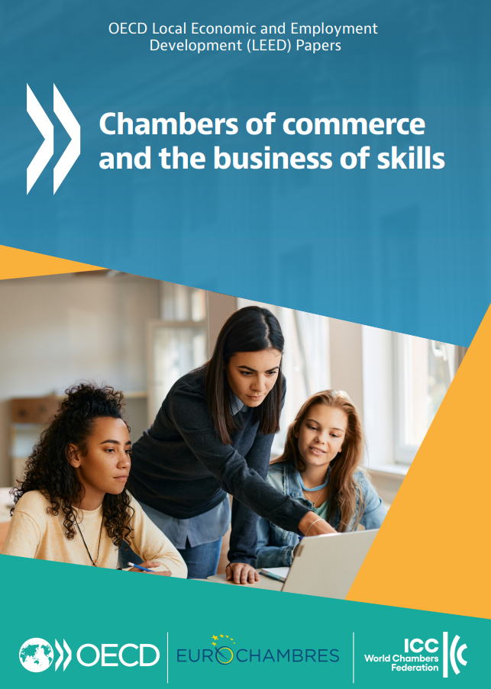
Cámaras de Comercio y el negocio de las habilidades 8 de julio, 2025 – Barranquilla, CO
Anni Huovinen
Analista de Políticas Públicas
Programa de Empleo Local y Desarrollo Económico (LEED)
Centro para el Emprendimiento, las PYMES, Regiones y Ciudades
Notes:
Thank you Tild
Pleased to be here today to present the results of a new landscaping survey looking specifically at the role of chambers of commerce in designing and delivering skills policies.
Want to warmly thank Eurochambres and the International Chamber of Commerce for collaborating with us on this work.

Slide 2
Encuesta OCDE-Eurocámaras-CCI 2024
Explora las actividades de las cámaras en el diseño y la implementación de políticas de habilidades, desde la formación inicial hasta el aprendizaje de adultos
136 respuestas, que abarcan 65 países y regiones
Los encuestados incluían cámaras nacionales, regionales, locales y transnacionales
Notes:
So that leads us to the 2024 OECD-Eurochambres-ICC survey. This survey, conducted earlier this year, is intended to provide a snapshot of how chambers around the world engage in the design and delivery of skills policies. There’s a lot of information available about the activities of chambers in specific countries, such as Germany where they traditionally play an important role in vocational education; but to our knowledge, there was relatively little information available that took a more systematic approach across countries.
With this survey, we were able to map the activities of chambers in 65 countries and transnational regions. Respondents ranged from national chambers to regional and local chambers to bilateral or transnational chambers.
For us, this is really the first step of mapping the broader landscape of chamber engagement in skills policies and we hope will provide a basis for further in-depth work.

Slide 3
Por qué las políticas de habilidades son importantes para las cámaras (y viceversa)
En todas partes de la OCDE, empresas se enfrentan a crecientes dificultades para contratar trabajadores con las competencias adecuadas
El alcance de los sistemas de habilidades varía considerablemente entre países y dentro de ellos
Los sistemas de competencias deben ser reevaluados y más ágiles para responder a las cambiantes necesidades del mercado laboral, y el apoyo de los empleadores es clave para lograrlo
Share of employers reporting difficulties in recruiting skilled talent
Source: Manpower (2024)
36%
75%
2014
2024
Notes:
Just like Karen explained in her intervention, the need to revamp skills systems is there. , let’s recall why skills policies matter for chambers and chambers matter for skills policies.
I know I’m preaching to the choir here, but businesses across the OECD are facing pressing labour and skills shortages that are unlikely to go away any time soon. A 2024 survey by Manpower showed that 75% of firms reported difficulties in recruiting skilled talent, up from 36% in 2014.
Across the OECD, about four in ten adults participate in job-related training annually, but there are important differences across and within countries. For example, within countries, the share can vary 2 fold or more across regions.
In light of the twin transitions, skills systems need to be more agile to respond to changing labour market needs and employer engagement is an important means to do so.

Slide 4

Cúal es el valor de las cámaras en navegar estos retos?
Canal para Necesidades Empresariales
Cámaras poseen información en tiempo real sobre las demandas y brechas de habilidades actuales y futuras. Pueden agregar y articular las necesidades empresariales en diálogos políticos.
Socios y Agentes Intermediarios de Confianza
Con sus canales de diálogo establecidos, las cámaras pueden cerrar brechas entre el sector público, los proveedores de educación y formación, y el sector privado.
Vínculo entre Habilidades Locales y Desarrollo Económico
El sector privado aporta una visión a largo plazo y un profundo conocimiento del mercado, ayudando a alinear las estrategias de habilidades con el desarrollo económico y a identificar cómo adaptar las competencias al potencial local
Fortalecimiento de capacidades y apoyo para pequeñas empresas
Las cámaras pueden ayudar a las pequeñas empresas con recursos limitados a abordar sus necesidades de habilidades y a fortalecer sus capacidades
Notes:
Unsurprisingly, we found that chamber engagement really varies across and within countries depending on a number of factors.
First, the legal status of chambers in a given country. In some countries, including many in continental Europe, chambers are established under public law, meaning that business membership is mandatory and they have delegated public functions and/or official advisory statuses. In other countries, including many Anglo Saxon countries, chambers are established under private law, with no mandatory membership and limited public functions. In some countries, chambers operate under hybrid law models, for example where business membership is not mandatory but chambers have delegated public functions.
The institutional framework for social partner and stakeholder engagement in skills systems also varies across countries, with a role for employers more or less “built in” into the design of skills systems. I also want to recall here that when we talk about the institutional framework, we also have to consider the role of other types of social partners, including employer associations and trade untions.
Finally, particularly in private law countries, a lot also depends on the priorities and capacities of any given regional or local chamber. So in these countries, there is more diversity in terms of how chambers engage.
So with that, let me share some of the main results of the survey, I invite you to check out the full results in the paper released today, which we will link in the chat.

Slide 5



La participación de las cámaras varía entre países y dentro de ellos, dependiendo de…
Estatus legal de las cámaras (derecho público, derecho privado o híbrido)
Marco institucional para la participación de los “partners”y las partes interesadas en los sistemas de competencias
Capacidades y prioridades de las cámaras
Notes:
Unsurprisingly, we found that chamber engagement really varies across and within countries depending on a number of factors.
First, the legal status of chambers in a given country. In some countries, including many in continental Europe, chambers are established under public law, meaning that business membership is mandatory and they have delegated public functions and/or official advisory statuses. In other countries, including many Anglo Saxon countries, chambers are established under private law, with no mandatory membership and limited public functions. In some countries, chambers operate under hybrid law models, for example where business membership is not mandatory but chambers have delegated public functions.
The institutional framework for social partner and stakeholder engagement in skills systems also varies across countries, with a role for employers more or less “built in” into the design of skills systems. I also want to recall here that when we talk about the institutional framework, we also have to consider the role of other types of social partners, including employer associations and trade untions.
Finally, particularly in private law countries, a lot also depends on the priorities and capacities of any given regional or local chamber. So in these countries, there is more diversity in terms of how chambers engage.
So with that, let me share some of the main results of the survey, I invite you to check out the full results in the paper released today, which we will link in the chat.

Slide 6
Entonces, ¿qué suelen hacer las cámaras?
Notes:
First is that chambers are frequently engaged in strategic leadership, such as sitting on advisory councils or contributing to the development of overarching strategies at national, regional and local levels. For example, you can see in the chart that in about 75% of countries, chambers reported providing inputs to national skills strategies.
The Canadian Chamber of Commerce has two policy committees involved in designing skills policies. The Workforce Strategies Committee focuses on federal labour policy, skills challenges, and immigration, while the Inclusive Growth Committee addresses labour market inequalities to support underrepresented groups. These committees, comprising members from chambers, businesses, industries, and educational institutions, adopt a multisectoral approach to influence policy and government decisions through regular engagement with public officials and participation in national workforce development conversations (Canadian Chamber of Commerce, n.d._{[16]}).
In Chile, the Cámara de Comercio de Santiago (the Santiago Chamber of Commerce – CCS). hosts the Advisory Board on Digital Talent. It provides a platform for leading e-commerce companies to participate in identifying specific talent gaps for electronic commerce and collaborate with higher education institutions to improve their curriculums to better respond to demand (Cámara de Comercio de Santiago, n.d._{[20]}).

Slide 7



Los tres pilares
Liderazgo y estrategias
Intermediación, Supervisión y Administración
Prestación de servicios
Notes:
Unsurprisingly, we found that chamber engagement really varies across and within countries depending on a number of factors.
First, the legal status of chambers in a given country. In some countries, including many in continental Europe, chambers are established under public law, meaning that business membership is mandatory and they have delegated public functions and/or official advisory statuses. In other countries, including many Anglo Saxon countries, chambers are established under private law, with no mandatory membership and limited public functions. In some countries, chambers operate under hybrid law models, for example where business membership is not mandatory but chambers have delegated public functions.
The institutional framework for social partner and stakeholder engagement in skills systems also varies across countries, with a role for employers more or less “built in” into the design of skills systems. I also want to recall here that when we talk about the institutional framework, we also have to consider the role of other types of social partners, including employer associations and trade untions.
Finally, particularly in private law countries, a lot also depends on the priorities and capacities of any given regional or local chamber. So in these countries, there is more diversity in terms of how chambers engage.
So with that, let me share some of the main results of the survey, I invite you to check out the full results in the paper released today, which we will link in the chat.

Slide 8

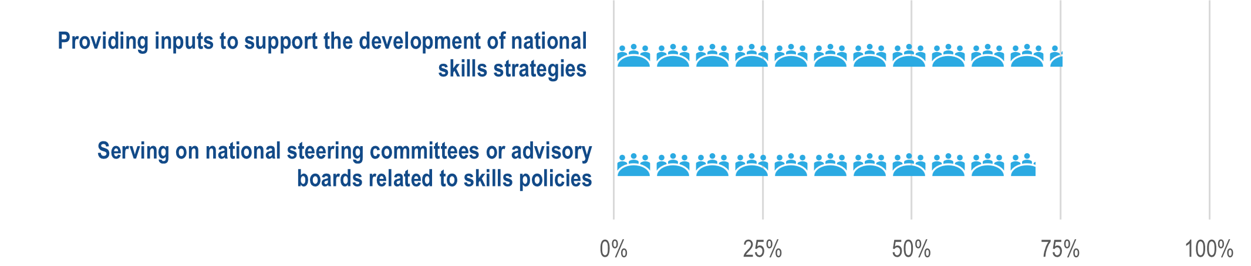
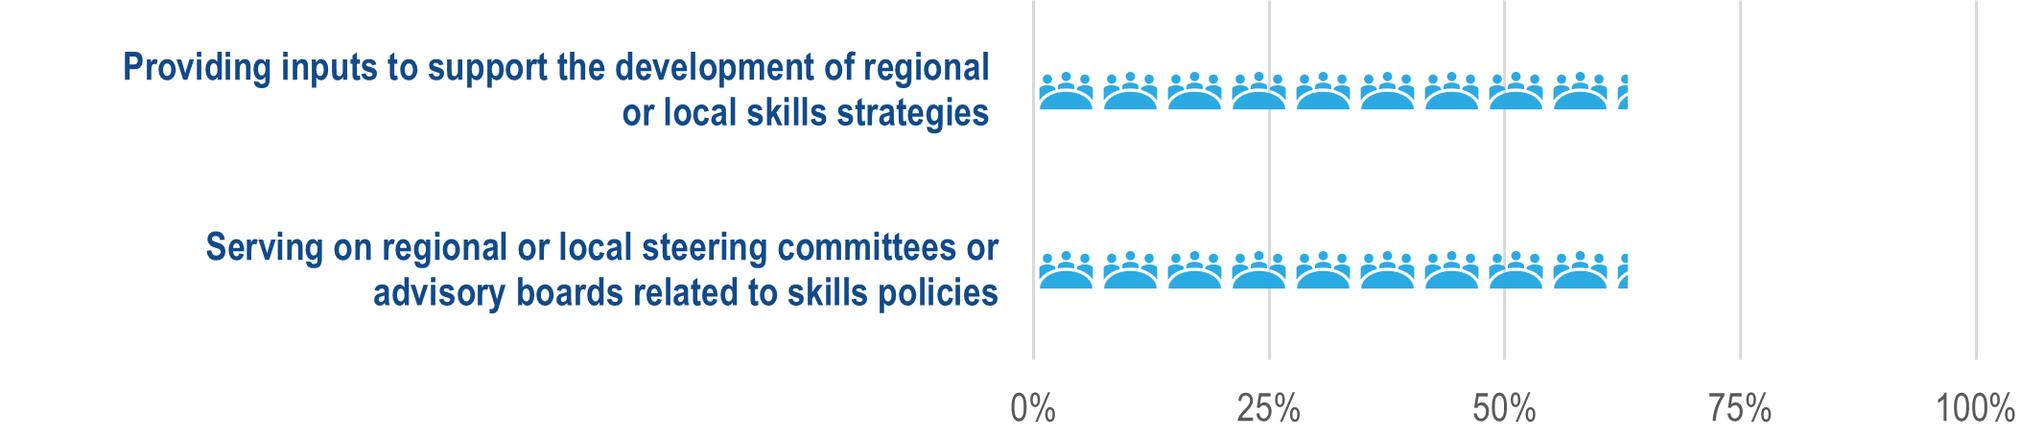
Liderazgo estratégico a nivel nacional, regional y local
Ideas Inspiradoras
Chile: Cámara de Comercio de Santiago
Junta Asesora de Talento Digital: Plataforma para empresas de e-commerce.
Identifica brechas de talento digital.
Colabora con universidades para adaptar currículos a la demanda.
Italia: Anticipación de Habilidades de Unioncamere
Encuesta Excelsior: Principal ejercicio de evaluación y anticipación de habilidades.
Recopila necesidades laborales y de habilidades de 450.000-500.000 empresas anualmente.
Resultados disponibles a nivel nacional, regional, subregional y por sector/tamaño de empresa.
Notes:
First is that chambers are frequently engaged in strategic leadership, such as sitting on advisory councils or contributing to the development of overarching strategies at national, regional and local levels. For example, you can see in the chart that in about 75% of countries, chambers reported providing inputs to national skills strategies.
The Canadian Chamber of Commerce has two policy committees involved in designing skills policies. The Workforce Strategies Committee focuses on federal labour policy, skills challenges, and immigration, while the Inclusive Growth Committee addresses labour market inequalities to support underrepresented groups. These committees, comprising members from chambers, businesses, industries, and educational institutions, adopt a multisectoral approach to influence policy and government decisions through regular engagement with public officials and participation in national workforce development conversations (Canadian Chamber of Commerce, n.d._{[16]}).
In Chile, the Cámara de Comercio de Santiago (the Santiago Chamber of Commerce – CCS). hosts the Advisory Board on Digital Talent. It provides a platform for leading e-commerce companies to participate in identifying specific talent gaps for electronic commerce and collaborate with higher education institutions to improve their curriculums to better respond to demand (Cámara de Comercio de Santiago, n.d._{[20]}).

Slide 9

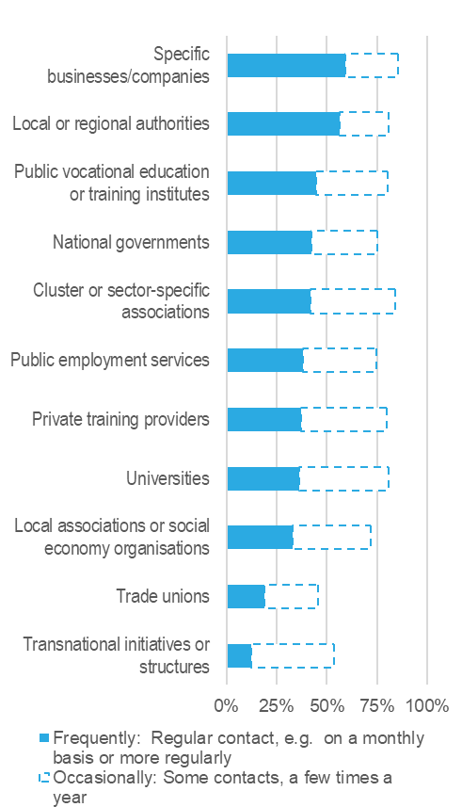

Un intermediario entre empresas, gobiernos, institutos de formación y aprendices
Con qué frecuencia las cámaras reportan trabajar con diferentes actores en apoyo a las políticas y programas de hablilidades
77% de las cámaras sirven una función de intermediación
60% de las cámaras están en contacto con las autoridades regionals y locales con frecuencia
Ideas Inspiradoras
Australia: Apprenticeship Support Australia (ASA)
Red de apoyo a la contratación, formación y retención de aprendices en Australia.
Colabora con escuelas, empresas y aprendices.
Objetivo: Mejorar retención, finalización y satisfacción.
Enfoque: Reducir la carga administrativa y centralizar al aprendiz
Zambia: Alianza formalizada con servicios públicos de Formación y la cámara nacional
Objetivo: Colaboración para avanzar educación técnica, vocacional y formación empresarial.
Notes:
Chambers also play an important intermediary role between businesses, governments, training institutes and learners.
You can see on the chart, for example, that in over half of countries, chambers reported being in contact with local or regional authorities on a monthly basis or more in relation to skills policies and programmes.
Skillnet Ireland is the national talent development agency of the Irish government, enhancing business competitiveness, productivity, and innovation through enterprise-led workforce development. Ten regional Skillnet Business Networks, linked to various Irish Chambers, offer subsidized learning programmes to help businesses develop their workforce skills. These multi-sector networks cater to companies of all sizes, providing flexible talent development solutions to support growth (Skillnet Ireland, n.d._{[34]}).
Apprenticeship Support Australia (ASA), a joint undertaking of Business New South Wales, the Victorian Chamber of Commerce and Industry in Victoria, and the Chamber of Commerce and Industry in Western Australia, is one of the providers in the government’s Australian Apprenticeship Support Services network. With over 400 staff across all states, ASA collaborates with schools, businesses, apprentices and trainees to make it easier to recruit, train and retain apprentices. The work is focused on improving retention, completion, and satisfaction rates; placing the apprentice at the centre of the services delivery; providing an assessment to Australian Apprentices and nominated Employers that are identified as needing support; improving wraparound services; deliver high quality end to end services and minimising and reducing the administration burden. Another central goal of the programme is to improve wraparound support for those who might have been underserved in the past or face barriers in completing their apprenticeship. Four groups have been identified as Key Client Groups (KCG) including First Nations Australian apprentices, women in male-dominated trades, apprentices with disability and apprentices located in remote Australia (Apprentice Support Australia, n.d._{[21]}).

Slide 10
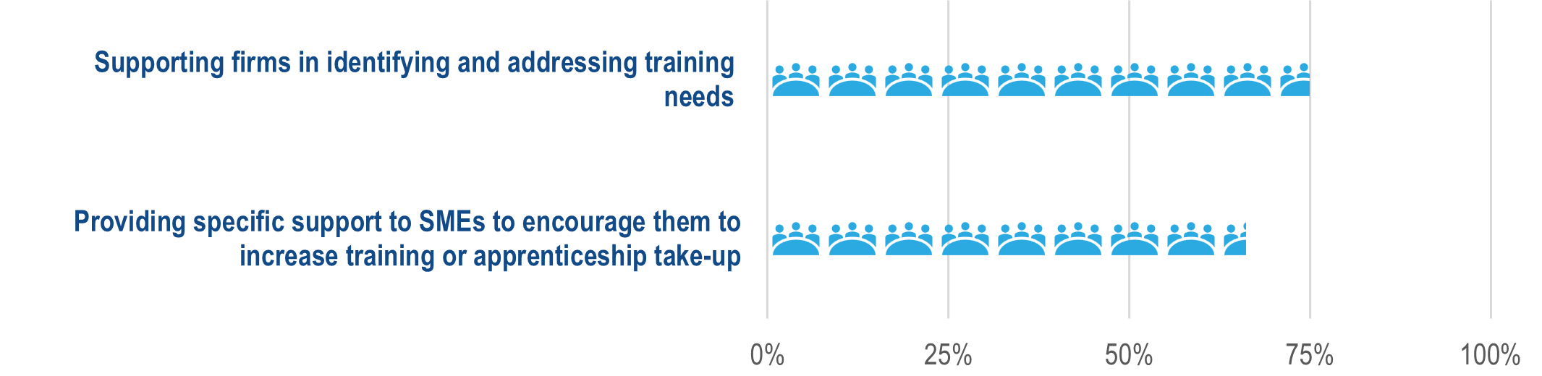
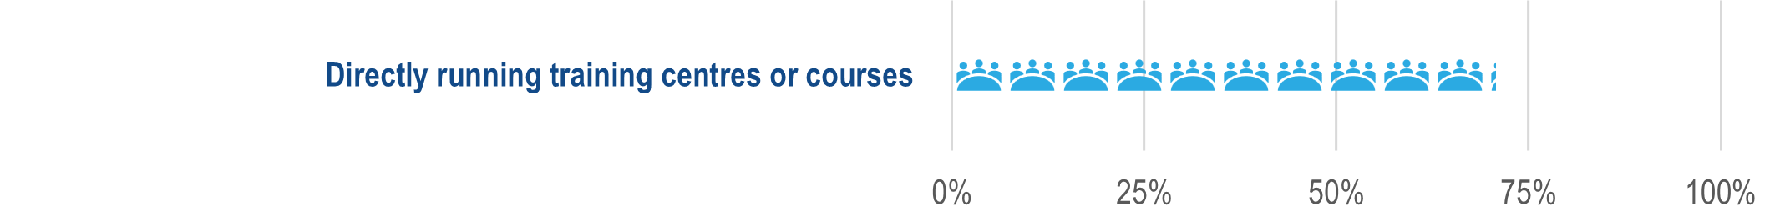
Prestación de servicios
House of Training (Luxemburgo):
Creada por la Cámara de Comercio y la Asociación de Banqueros de Luxemburgo, la House of Training ofrece formación a líderes y empleados empresariales, con el enfoque "profesionales forman a profesionales", con capacitadores que son predominantemente empresarios expertos
Cámaras de Comercio e Industria (Francia):
Amplia red educativa: 131 centros de aprendizaje, 143 de formación continua, 18 escuelas de negocios, 16 de gestión y 9 de ingeniería.
Demuestra la institucionalización y escala del compromiso de las cámaras con la formación.
Notes:
Finally, the role of chambers in directry providing training or related services should not be overlooked.
They work with firms to help them identify and address training needs, including frequently with SMEs who may not have their own internal capacities to do so.
They also provide training directly, particularly training with concrete links to the world of work.
The House of Training, an approved continuing vocational training organisation in Luxembourg, was created in 2015 by the Chamber of Commerce and the Luxembourg Bankers’ Association. It provides training for business leaders in the process of creating, taking over or managing companies, as well as employees of these companies The trainers are predominantly entrepreneurs, technical experts or representatives of other partners (e.g. professional associations”, in line with the programmes’ “’ “professionals train other professionals approach”. In 2022, 46 000 days of training were provided (House of Training, n.d._{[27]}).
In France, 400 000 people are trained annually via the Chambre de Commerce et d’Industrie France (CCI) network. Collectively, the chambers in this network run 131 apprenticeship training centres, 143 continuing vocational education centres, 18 business schools, 16 management schools, and 9 engineering schools (CCI France, n.d._{[24]}).
In Finland, many regional chambers of commerce own vocational schools, and the Helsinki Chamber of Commerce owns the Helsinki School of Business which offers bachelor’s degrees and MBAs (Helsinki School of Business, n.d._{[25]}).

Slide 11
Un proveedor de formación y servicios relacionados
Ideas Inspiradoras
Tipo de Innovación: Sistema de Calificación Modular Estandarizado para la mejora de cualificaciones.
El Rol de Cámaras: Emiten certificados modulares de habilidades vocacionales.
Beneficio: Permite adquirir habilidades incrementalmente, con evaluación y certificación.
Relevancia: Vía flexible hacia cualificaciones completas, ideal para trabajadores informales/no certificados
Calificación Parcial en Alemania y su Potencial en Países como Colombia
Notes:
Finally, the role of chambers in directry providing training or related services should not be overlooked.
They work with firms to help them identify and address training needs, including frequently with SMEs who may not have their own internal capacities to do so.
They also provide training directly, particularly training with concrete links to the world of work.
The House of Training, an approved continuing vocational training organisation in Luxembourg, was created in 2015 by the Chamber of Commerce and the Luxembourg Bankers’ Association. It provides training for business leaders in the process of creating, taking over or managing companies, as well as employees of these companies The trainers are predominantly entrepreneurs, technical experts or representatives of other partners (e.g. professional associations”, in line with the programmes’ “’ “professionals train other professionals approach”. In 2022, 46 000 days of training were provided (House of Training, n.d._{[27]}).
In France, 400 000 people are trained annually via the Chambre de Commerce et d’Industrie France (CCI) network. Collectively, the chambers in this network run 131 apprenticeship training centres, 143 continuing vocational education centres, 18 business schools, 16 management schools, and 9 engineering schools (CCI France, n.d._{[24]}).
In Finland, many regional chambers of commerce own vocational schools, and the Helsinki Chamber of Commerce owns the Helsinki School of Business which offers bachelor’s degrees and MBAs (Helsinki School of Business, n.d._{[25]}).

Slide 12



Donde las cámaras están bien posicionadas para contribuir
GESTIÓN DE FORMACIÓN
Formación de temas “management”– ej. Recursos humanos, exportaciones
Formación para emprendedores y pymes
Formación de formadores
Bélgica: Red de aprendizaje PLATO para emprendedores
Polonia: Academia de Gestores de PYMES
APRENDICES ADULTOS
Formación en el puesto de trabajo
Desarrollo de habilidades básicas para personas que buscan empleo
Formación dirigida a colectivos específicos (por ejemplo migrantes)
Capacitación específica por sector u ocupación
Integración de personas refugiadas en Noruega
JÓVENES / NUEVOS ENTRANTES AL MERCADO LABORAL Programas de aprendizaje / formación profesional dual postsecundaria Educación técnica y profesional a nivel secundario Institutos politécnicos
España: Garantía Juvenil Turquía: Mi profesión, mi futuro
Notes:
Finally, the role of chambers in directry providing training or related services should not be overlooked.
They work with firms to help them identify and address training needs, including frequently with SMEs who may not have their own internal capacities to do so.
They also provide training directly, particularly training with concrete links to the world of work.
The House of Training, an approved continuing vocational training organisation in Luxembourg, was created in 2015 by the Chamber of Commerce and the Luxembourg Bankers’ Association. It provides training for business leaders in the process of creating, taking over or managing companies, as well as employees of these companies The trainers are predominantly entrepreneurs, technical experts or representatives of other partners (e.g. professional associations”, in line with the programmes’ “’ “professionals train other professionals approach”. In 2022, 46 000 days of training were provided (House of Training, n.d._{[27]}).
In France, 400 000 people are trained annually via the Chambre de Commerce et d’Industrie France (CCI) network. Collectively, the chambers in this network run 131 apprenticeship training centres, 143 continuing vocational education centres, 18 business schools, 16 management schools, and 9 engineering schools (CCI France, n.d._{[24]}).
In Finland, many regional chambers of commerce own vocational schools, and the Helsinki Chamber of Commerce owns the Helsinki School of Business which offers bachelor’s degrees and MBAs (Helsinki School of Business, n.d._{[25]}).

Slide 13
Pero hay oportunidades para que las cámaras contribuyan aún más a estas estrategias…
Ayudando a las PYMES a afrontar las transiciones: Asistir a las pequeñas y medianas empresas (PYMES) en su adaptación a las transiciones digital y verde, facilitando el acceso a habilidades y formación relevantes, y incluso prestándoles servicios directamente
Integrando Políticas de Habilidades y Desarrollo Económico: Fortalecer los vínculos entre las políticas locales de habilidades y las estrategias más amplias de desarrollo económico para asegurar la alineación y maximizar el impacto
Expandiendo el Aprendizaje en el Lugar de Trabajo: Promover y expandir las oportunidades de aprendizaje directamente dentro del entorno laboral, beneficiando tanto a los nuevos profesionales como a aquellos a mitad de carrera
Fomentando Prácticas de Contratación Inclusivas: Colaborar con los empleadores para fomentar enfoques de contratación basados en habilidades, aumentando así las oportunidades para grupos subrepresentados como populaciones migrantes.
Notes:
Finally, the role of chambers in directry providing training or related services should not be overlooked.
They work with firms to help them identify and address training needs, including frequently with SMEs who may not have their own internal capacities to do so.
They also provide training directly, particularly training with concrete links to the world of work.
The House of Training, an approved continuing vocational training organisation in Luxembourg, was created in 2015 by the Chamber of Commerce and the Luxembourg Bankers’ Association. It provides training for business leaders in the process of creating, taking over or managing companies, as well as employees of these companies The trainers are predominantly entrepreneurs, technical experts or representatives of other partners (e.g. professional associations”, in line with the programmes’ “’ “professionals train other professionals approach”. In 2022, 46 000 days of training were provided (House of Training, n.d._{[27]}).
In France, 400 000 people are trained annually via the Chambre de Commerce et d’Industrie France (CCI) network. Collectively, the chambers in this network run 131 apprenticeship training centres, 143 continuing vocational education centres, 18 business schools, 16 management schools, and 9 engineering schools (CCI France, n.d._{[24]}).
In Finland, many regional chambers of commerce own vocational schools, and the Helsinki Chamber of Commerce owns the Helsinki School of Business which offers bachelor’s degrees and MBAs (Helsinki School of Business, n.d._{[25]}).

Slide 14
De cara al futuro
¿Cuáles son las prioridades y los retos que enfrenta su comunidad empresarial?
¿Qué actividades relacionadas con habilidades están llevando a cabo o en las que están participando?
¿Qué mejores prácticas han identificado en sus propios contextos que la OCDE podría compartir internacionalmente?

